Slide 1



A Collaborative Event by :
Aegis & Gnosvia
Programmers’ Paradise Technical Society
August 23 , 2025

Slide 2
ARTIFICIAL INTELLIGENCE IN CYBERSECURITY
The Digital Arms Race: A New Era of Attack & Defence

Slide 3
Table Of Content
The Modern Threat Landscape: Why Cybersecurity is important ?
The New Battlefield: A Game of Wits, Attacker vs Defenders
Why AI is Game Changer ?
The Defender’s playbook: AI as a Shield
The Attacker’s Arsenal: AI as a Sword
Conclusion

Slide 4
The Modern Threat Landscape: Why Cybersecurity is Important ?

Slide 5
The Data Deluge: A Battle of Scale & Speed
Volume :
Microsoft analyse 78 trillion security events daily.
2000+ alerts per analyst, per shift
Only approximately 4% of alerts are investigated .

Slide 6
Case I : The Target Data Breach (2013)
Hackers breached the major US retailer Target, stealing the credit/debit card information of over 40 million customers.
Critical Threats Missed in the Noise.
Target had invested millions in a state-of-the-art malware detection system. This system actually detected the intrusion and sent alerts to the security team. However, due to the enormous volume of daily alerts the team received, these critical warnings were considered false positives and were lost in the noise. The team was so overwhelmed by the data deluge that they couldn't identify the legitimate, high-priority threat until it was too late.

Slide 7
Velocity:
Automated attacks achieve goals in under 5 minutes.
Average attacker “dwell time”: 200+ days.
Attacks operate at machine speed vs human speed.

Slide 8
Case II: The WannaCry Ransomware Outbreak (2017)
A massive ransomware worm spread across the globe, crippling hundreds of thousands of computers in over 150 countries.
WannaCry moved at unprecedented velocity. It exploited a vulnerability in Microsoft Windows and spread automatically, like a virus, without needing any human interaction. It crippled critical infrastructure, including hospitals in the UK's National Health Service (NHS), in a matter of hours. The speed of the attack was so fast that human IT teams simply could not patch systems or respond quickly enough to contain it.

Slide 9
Sophistication:
Polymorphic malware evades signature- based detection.
Rise of AI- powered phishing and deepfake attacks.
Constant emergence of zero-day exploits.

Slide 10
ZERO-DAY ATTACK ?

Slide 11
Case III: The SolarWinds (SUNBURST) Attack (2020)
Russian state-sponsored hackers compromised the software supply chain of a major IT management company, SolarWinds.
This attack was incredibly sophisticated. Instead of attacking their targets directly, the hackers injected malicious code into the legitimate software updates for SolarWinds' Orion product. This meant that thousands of organizations, including parts of the US government, unknowingly installed the malware themselves as part of a trusted update. The malware was stealthy, remained dormant for weeks, and used novel techniques to hide its communications, making it nearly impossible for traditional signature-based tools to detect.

Slide 12
Case IV: AI powered phishing , The Voice Deepfake Heist (2019)
The CEO of a UK-based energy firm received a phone call from someone who sounded exactly like his boss, the CEO of the parent company in Germany. The voice clone urgently requested he transfer €220,000 to a Hungarian supplier, which he did. This was one of the first major, publicly reported crimes using AI-generated voice deepfakes.

Slide 13
The Human Bottleneck:
Analyst Burnout & Alert Fatigue
Critical Threats Missed in the Nosie
A Reactive Posture: Always One Step Behind

Slide 14
Case V: The Equifax Data Breach (2017)
The 2017 Equifax breach, which exposed the personal data of over 147 million people, is a definitive case study of a catastrophic failure caused by a human bottleneck.
In March 2017, a critical vulnerability was discovered in a web application framework called Apache Struts, which Equifax used. A patch was immediately available. The security team was notified and instructed to apply the patch within 48 hours.

Slide 15
The instruction was not followed correctly. An internal scan to find vulnerable systems failed to identify the specific server, leaving it unpatched. This initial failure in human process left the door wide open for hackers, who gained access in May.
The breach continued undetected for 76 days. The most critical failure was a security tool designed to inspect network traffic. This tool should have detected the hackers exfiltrating data, but it couldn't because a single security certificate had been expired for 10 months. The renewal of this certificate was a routine human task that was overlooked. Because of this one missed task, the automated security system was blind, and no human analyst ever saw the alerts that would have stopped the breach.

Slide 16
HOW CAN WE FIGHT AN AUTOMATED
ADVERSARY WITH A MANUAL DEFENSE ?

Slide 17
The New Battlefield

Slide 18
A Game of Wits: Attacker vs Defender
Defender | Attacker
Reactive Posture | Proactive & Persistent
Must Protect ALL assets | Needs Only ONE Vulnerability
Cannot Afford a Single Failure | Can Attempt Thousands of Attacks
Limited by Human Resources & Time | Leverages Automation & Scale

Slide 19
Why AI is the Game Changer ?
THE AI ADVANTAGE: AUGMENTING HUMAN DEFENSE
SCALE | SPEED | PREDICTION
Analyses billions of data points in real-time | Detects and responds at machine speed | Moves from reactive to proactive defence
Eliminate alert fatigue by surfacing true threats | Reduces attacker dwell time from months to minutes | Identifies novel, zero-day attacks without signatures

Slide 20
Ingest Data
Train Model
Detect Threats
Gather Feedback

Slide 21
Supercharging The Analyst
From Bottleneck to Battle Ready
“AI doesn’t replace the analyst .
It empowers them, turning a human bottleneck into a
formidable human- machine team.”

Slide 22
The Defender’s Playbook
A Deep Dive Into Predictive Vulnerability Prioritization

Slide 23
The Problem: Vulnerability Overload
A large enterprise can have over 1 million known vulnerabilities across its system
Most security teams rely on the CVSS (Common Vulnerability Scoring System).
CVSS scores are static and lack context. A "critical" vulnerability on a test server is not as urgent as a "high" one on your main web server.
Teams waste time patching vulnerabilities that pose no real threat, while truly dangerous ones get lost in the backlog.

Slide 24
CVSS
Base metrics
Inherent vulnerability characteristics:
Attack vector (AV)
Can an attacker exploit the vulnerability over a network, locally or physically?
Remote flaws (AV: N) score higher.
Attack complexity (AC)
Does the exploit require configuration quirks, timing or uncommon system states?
Privileges required (PR)
How much access does an attacker need before they can exploit the vulnerability?
User interaction (UI)
Does the attack require a user to click a link, open a file or take other actions?
Scope (S)
Does the vulnerability affect only the component or have a cross-boundary impact?
Impact (CIA)
Measures confidentiality, integrity and availability loss.

Slide 25
Severity bands
CVSS scores then fall into these severity bands:
None (0.0)
Low (0.1–3.9)
Medium (4.0–6.9)
High (7.0–8.9)
Critical (9.0–10.0)

Slide 26
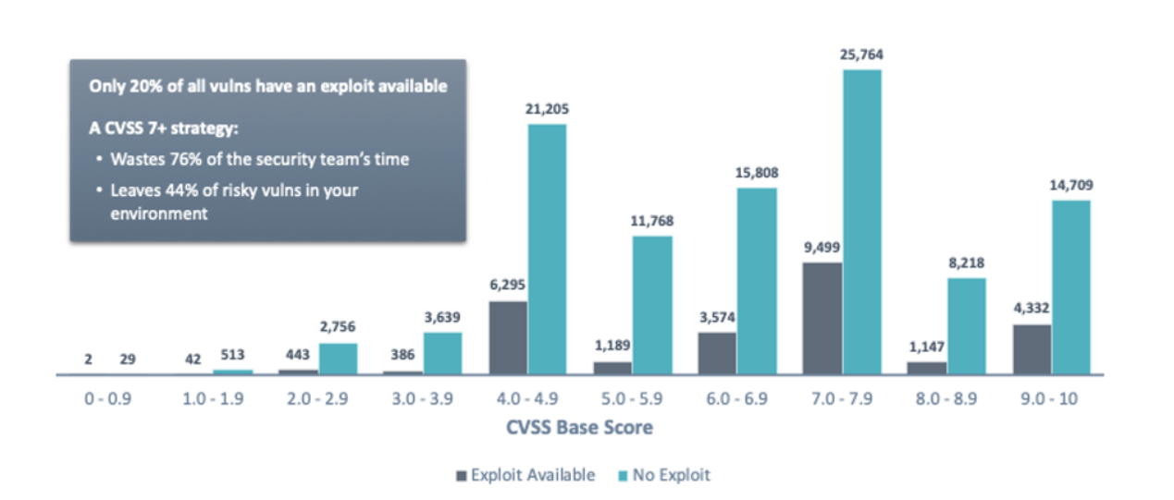
Credit: Tenable

Slide 27
CVSS creates a false sense of security
The bottom line is, CVSS has been the industry standard for so long that many security professionals believe it’s the best, if not only, way to prioritize their vulnerability remediation efforts. But, considering the many downfalls of CVSS, it’s easy to see that CVSS is an outdated, ineffective method.

Slide 28
The AI Solution: From a Long List to a Smart List
BEFORE AI | AFTER AI
A long, unordered list of 1000s of vulnerabilities. | A short, focused list of the top 10-20 most dangerous
Sorted by a generic severity score. | Scored based on the real-time likelihood of being exploited in your environment.
Result: Reactive and inefficient. | Result: Proactive, efficient, and risk-focused.

Slide 29
Technical Deep Dive: The Prediction Engine
Regression | Classification
Goal: Predict a precise risk score (e.g., 0-100). | Goal: Assign a clear, actionable category (e.g., Critical, Urgent, Monitor).
Analogy: A weather forecast giving an "85% chance of being exploited." | Analogy: A weather app issuing a "Tornado Warning!"
Use Case: Perfect for ranking vulnerabilities against each other with high granularity. | Use Case: Perfect for creating automated workflows and tickets for security teams.

Slide 30
The Algorithm
XGBOOST | NEURAL NETWORKS
A powerful and efficient tree-based algorithm. | A model inspired by the human brain.
Why it's used: Excellent for structured, tabular data like vulnerability reports. It's an industry-proven workhorse known for its speed and accuracy. | Why it's used: Can uncover complex, non-linear patterns from vast amounts of unstructured threat data (like hacker forum chatter) that other models might miss.

Slide 31
Fueing the Engine; The Data Sources
Vulnerability Data: CVE details, CVSS scores, software weaknesses (CWEs).
Threat Intelligence Feeds: Real-time data on active exploits, malware, and dark web chatter.
Asset Criticality: Is the asset a public web server or an isolated test machine?
Network Context: How exposed is the asset? Is it protectd by a firewall?
Historical Data: Has our organisation been attacked via this type of vulnerability before?

Slide 32
From Lab to Live: Operationalizing The AI
Build & Train
Deploy & Integrate
Optimize & Monitor
Online learning

Slide 33
The Impact: Measuring the Results
Focuses team efforts on the 1% of vulnerabilities that truly matters
Proactively closes the doors hackers are most likely to knock on.
Reducing alert fatigue and burnout by eliminating noise
Finally allows the security team to move from a reactive to a proactive, predictive posture

Slide 34
The Attacker’s Arsenal
Game Theory and the Rise of Adversarial AI

Slide 35
The Strategic Framework: Game Theory
Game Theory is the study of strategic interaction between rational players. In cybersecurity, the primary players are the Attacker and the Defender.
Attacker's Goal: Maximize the chance of a successful breach at the lowest cost.
Defender’s Goal: Minimize the chance of a breach with a limited budget.
The Key Insight: The best move for one player depends entirely on the actions of the other. As defenders adopt AI, attackers must change their game.

Slide 36
Adversarial AI : Intentionally deceiving AI model with malicious inputs
Adversarial AI is a technique that aims to fool or manipulate machine learning models by providing deceptive data. In cybersecurity, this means making AI-driven security tools blind to threats.
Common Attack Methods:
Evasion: The attacker makes small changes to malicious code or data (like a virus) so that it's no longer recognized by the AI security model.
Poisoning: The attacker secretly feeds bad information into the AI's training data, creating a "backdoor" or blind spot they can exploit later.
Model Stealing: The attacker probes the AI model to learn how it works, allowing them to reverse-engineer it or steal the intellectual property.

Slide 37
The Intersection: Cybersecurity as a Strategic Game
We can model the conflict between a cyber attacker and a defender as a strategic game.
The Players:
Attacker (Adversary) : Wants to bypass security, steal data, or cause damage. Their payoff is high when an attack succeeds.
Defender (Cybersecurity AI) : Wants to detect and block attacks to maintain system integrity. Their payoff is high when the system is secure.

Slide 38
Why Game Theory is a Perfect Fit
It provides a formal way to analyze the constant back-and-forth between attackers and defenders.
It helps us move beyond static defenses and create strategies that anticipate and counter the adversary's moves.

Slide 39
Practical Example: An AI Intrusion Detection System (IDS)
The Game:
Defender’s Strategy: Where should it allocate its limited computational power?
Option A: Heavily monitor web traffic
Option B: Heavily monitor database access.
Option C: Distribute monitoring evenly

Slide 40
ii. Attacker’s Strategy: Which vector should they use ?
Option 1: Exploit a web server vulnerability.
Option 2: Use a phishing email to steal credentials.
Option 3: Launch an SQL injection attack on the database.

Slide 41
Game Theory’s Role
By creating a payoff matrix, the defender can analyze the potential outcomes of each combination of choices. This allows them to determine the optimal, most robust defense strategy that minimizes potential damage, regardless of what the attacker chooses to do.

Slide 42
“As we are seeing, Artificial Intelligence (AI) technologies are set to become a major focus of regulators and industry. We will undoubtedly see attackers using AI as a tool to refine phishing messages, develop malware and enable other abuses of technology. But AI will also be a critical component of successful defense. For example, in Ukraine we saw the first successful use of AI technology to help defend against Russian cyberattacks. In the coming years, innovation in AI‑powered cyber defense will help reverse the tide of cyberattacks. ”
Tom Burt (2023)
Corporate Vice President, Customer Security & Trust, Microsoft

Slide 43
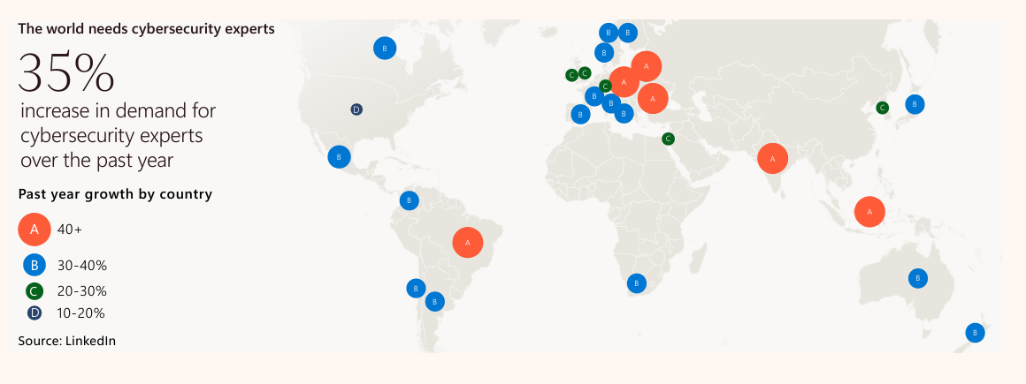

Slide 44
Thankyou for attentive and Patiently listening

Slide 45

Please fill out this form:
https://forms.gle/rg6Tj1ZKSRqwPFUD8

Slide 46
Resources Used from:
https://www.microsoft.com/en-us/security/security-insider/threat-landscape/microsoft-digital-defense-report-2023
https://www.microsoft.com/en-us/security/security-insider/threat-landscape/microsoft-digital-defense-report-2024
https://www.tenable.com/blog/beyond-cvss-why-organizations-need-vpr-for-vulnerability-prioritization
https://atlas.mitre.org/
https://www.wired.com/story/machine-learning-makes-it-easy-to-fool-ai-image-recognition/

